Slide 1
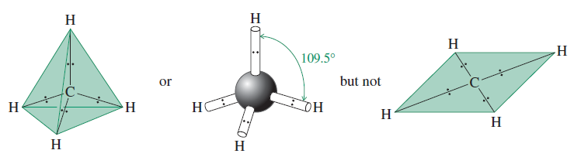
Valence –shell electron-pair repulsion (VSEPR) theory: predicting geometry
Shapes and bond angles of molecules can be predicted by VSEPR theory
The method for determining molecular shape by minimizing electron
repulsion is called VSEPR method
The Lewis structure for methane (CH₄) shows a carbon atom surrounded
by four regions of electron density. Each region contains a single pair of
electrons forming a bond to a hydrogen atom.
According to VSEPR, the four regions radiate from carbon so that they are
as far away from each other as possible.

Slide 2
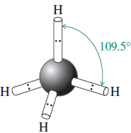
Placing the four hydrogens at the vertices of a tetrahedron minimizes
the electron repulsion of the corresponding bonding electron pairs
In other words, maximum separation between each region of electron
pairs occurs when the angle between any two pairs of electrons is 109.5°
Thus, H-C-H bond angles are 109.5° and the shape of methane molecule
is tetrahedral
Geometry of methane (CH₄) is tetrahedral

Slide 3
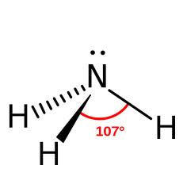
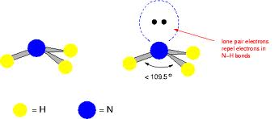
Shape of ammonia (NH₃) molecule:
The Lewis structure of NH₃ shows nitrogen surrounded by four regions
of electron density.
Three regions contain single pairs of electrons forming covalent bonds
with hydrogen atoms
The fourth region contains an unshared pair of electrons.
Using VSEPR, we can predict that the four regions of electron density
around nitrogen are arranged in a tetrahedral manner and that all H-N-H
bond angles are 109.5°.
The experimental observed bond angles are
107.3°.

Slide 4
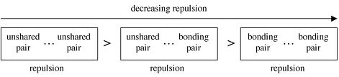
Reason:
Because the unshared pair of electrons on nitrogen repels adjacent
bonding electron pairs more strongly than bonding pairs repel each other.
Geometry of ammonia is pyramidal

Slide 5
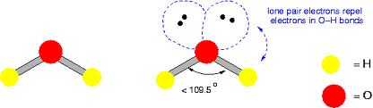
Geometry of water molecule:
In H₂0, oxygen is surrounded by four regions of electron density
Two of these regions contain single pairs of electrons forming covalent
bonds to two hydrogen
The remaining two contain unshared electron pairs
Using VSEPR, we can predict that the four regions of electron density
around oxygen are arranged in a tetrahedral manner and that the H-O-H
bond angle is 109.5°.
Experimental measurements show that the actual
H-O-H bond angle is 104.5°, smaller value than the predicted

Slide 6
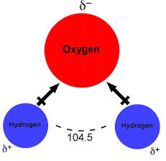
Reason:
Because the unshared pairs of electrons repel adjacent unshared pairs
of electrons more strongly than do bonding pairs
Geometry of water is bent

Slide 7
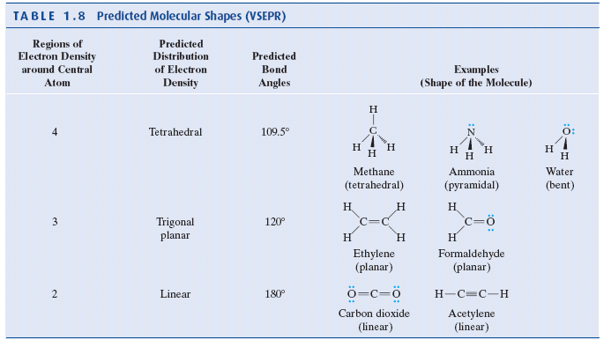
Predicted shapes of some molecules by VSEPR

Slide 8
Dipole Moments and Molecular Polarity
How to predict if a molecule is polar or nonpolar?
A molecule will be polar if
  It has polar bonds and
  Its centers of partial positive and partial negative charge lie at
  different places within the molecule
Dipole Moment (µ):
It is used as an indicator of polarity
µ is defined as the amount of partial charge (δ) on either end of the
dipole multiplied by the distance of separation (d)
µ = δ x d
Unit of dipole moment: Debye (D)

Slide 9
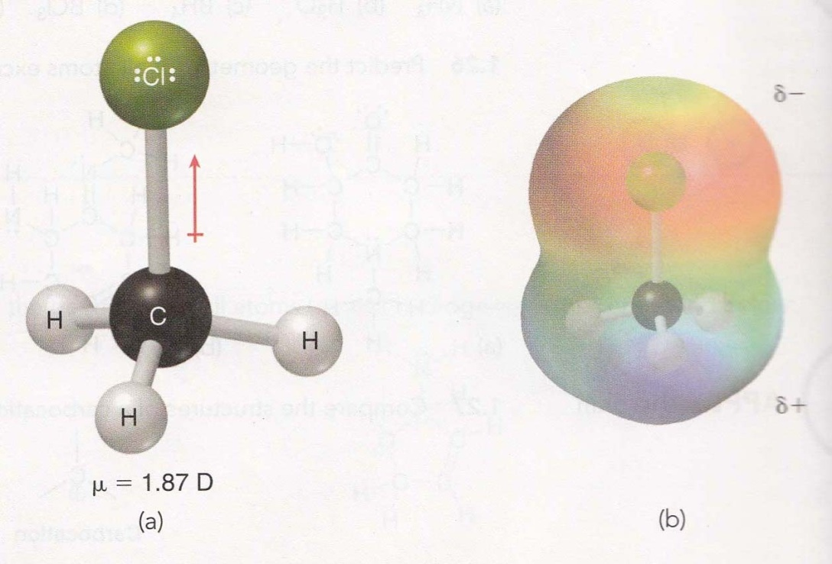
Example
Chloromethane (CH₃Cl):
It has only one polar bond
It exhibits a dipole moment, because the center of negative charge and
the center of positive charge are separated from one another by a certain
distance.
Dipole moment of chloromethane = 1.87 D

Slide 10
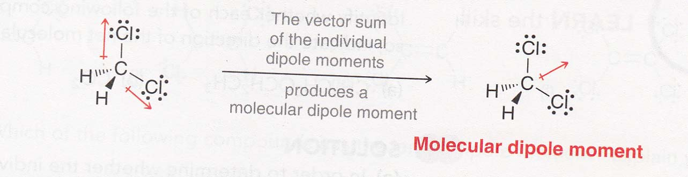
Molecular dipole moment:
When a compound has more than one polar bond, it is necessary to take
the vector sum of the individual dipole moments. The vector sum is called
the molecular dipole moment, and it takes into account both the
magnitude and the direction of each individual dipole moment.
Example: Dichloromethane (CH₂Cl₂)
Dipole moment of dichloromethane (CH₂Cl₂) = 1.14 D
Note: Dipole moment of CH₂Cl₂ is significantly smaller than the dipole
moment of CH₃Cl (µ = 1.87 D) because the two dipole moments in
CH₂Cl₂ partially cancel each other.

Slide 11
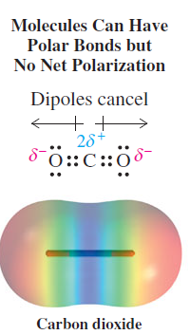
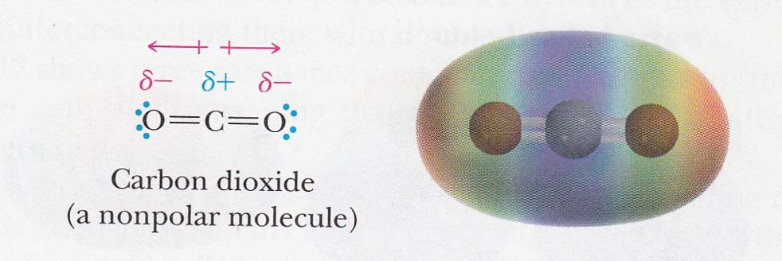
More examples:
CO₂
CO₂ has two polar carbon-oxygen double bond
CO₂ is linear. For this reason, the centers of negative and positive partial
charge coincide; therefore, CO₂ is nonpolar
In other words, the linear shape of CO₂ results in a cancellation of the
dipole moments. Thus CO₂ is nonpolar molecule

Slide 12
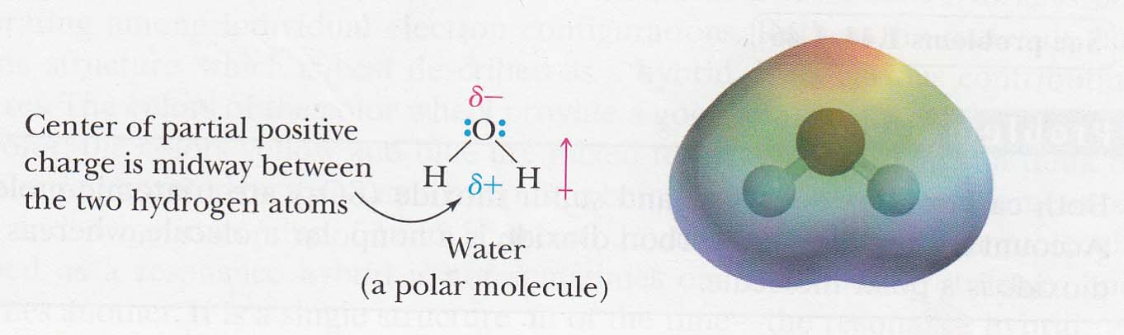
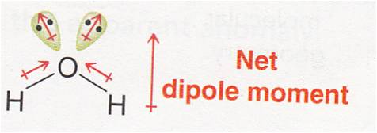
Water (H₂O)
H₂O has two polar O-H bond
H₂0 is a bent molecule. For this reason, the center of its partial positive
charge is between the two hydrogen atoms, and the center of its partial
negative charge is on oxygen.

Slide 13
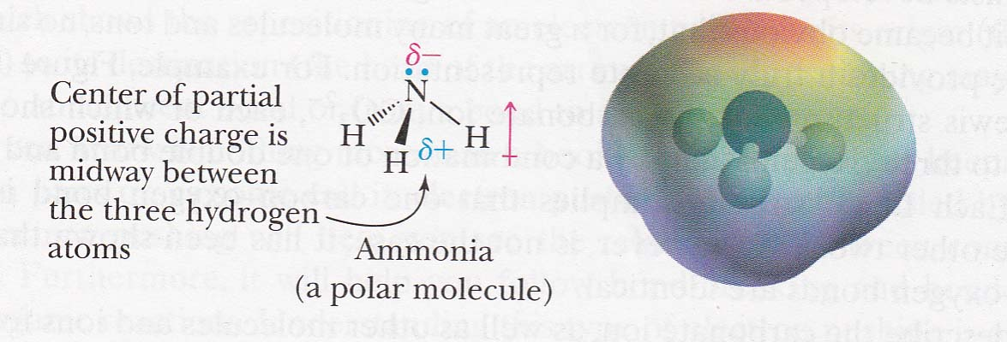
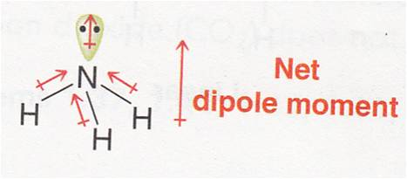
Ammonia (NH₃)
NH₃ has three N-H bonds
Geometry of ammonia is trigonal pyramidal
The centers of partial positive and negative charges are at different
places within the molecule, thus NH₃ is a polar molecule

Slide 14
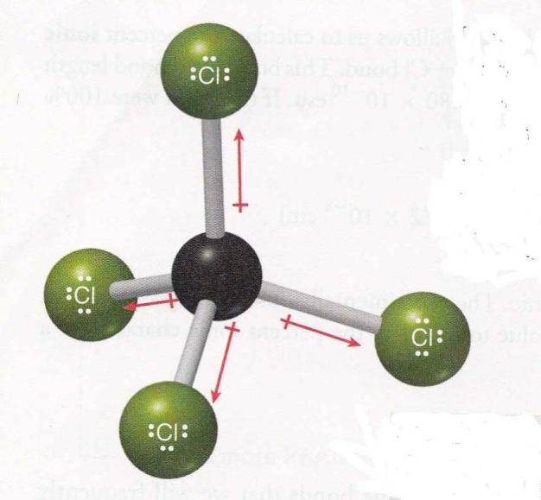
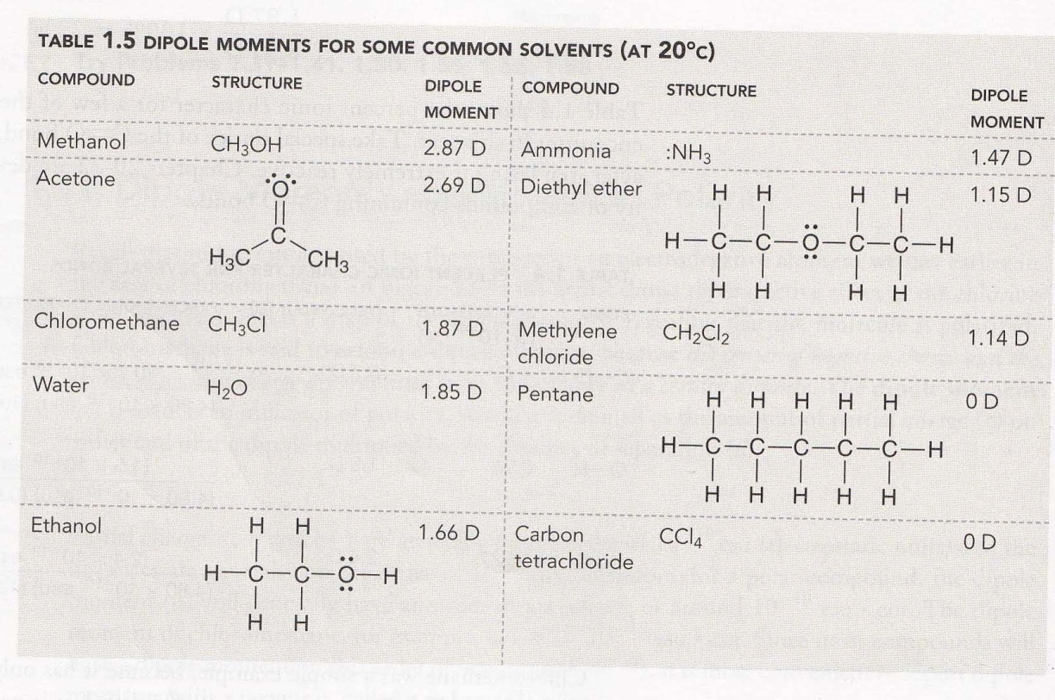
Carbon tetrachloride (CCl₄)
CCl₄ has no molecular dipole moment
Individual dipole moments cancel each other completely to give the
molecule a zero net dipole moment (µ = 0)
Table: Dipole moment of some molecules
CCl₄

Slide 15
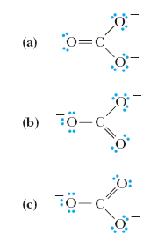
Resonance
Resonance theory describes molecules and ions for which no
single Lewis structure is adequate
Consider Lewis structure of carbonate ion (CO₃²⁻)
Three Lewis structures for CO₃²⁻ can be shown
Each structure shows carbon bonded to three oxygen atoms
by a combination of one double bond and two single bond
Each Lewis structure implies that one carbon-oxygen bond
is different from the other two
But this is not true
Experimentally it has been found that all three
carbon-oxygen bonds are identical
Fig. Three Lewis structures for the carbonate ion

Slide 16
To describe CO₃²⁻ no single Lewis structure is adequate
For this reason, we need resonance theory
According to this theory, many molecules and ions are best
described by writing two or more Lewis structures and considering
the real molecule or ion to be a composite of these structures
Individual Lewis structures are called resonance contributing
structures
The real molecule or ion is a resonance hybrid of the various
contributing structures by interconnecting them with two-headed
arrow
Resonance contributing structures: representation of a molecule or ion that differ only in the distribution of valence electrons

Slide 17
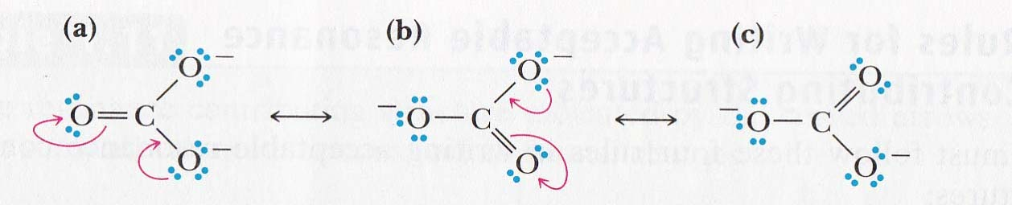
How to draw resonance structures?
Resonance structures are represented by two-headed arrow
and brackets around the structures
Curved arrow is used to show the redistribution of valence
electrons
Resonance structures of carbonate ion:
Carbonate ion is represented as a hybrid of three equivalent
contributing structures

Slide 18
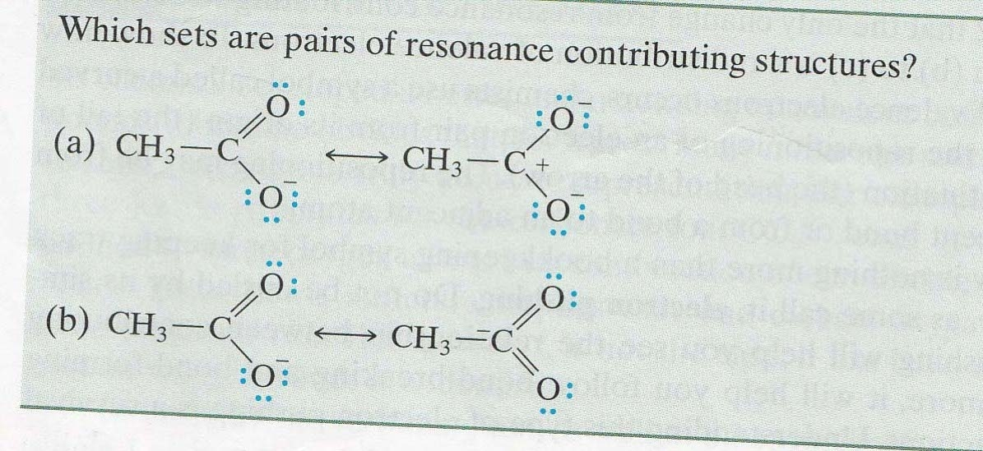
Problem 1

Slide 19
Solution of Problem 1
Contributing structures differ only in the distribution of the valence electrons, and each
Contributing structure itself must be a correct Lewis structure.
Pair (a) is the correct set of contributing structures
Pair (b) is not a set of contributing structures; although they differ in electronic
Distributions, the right in pair (b) violetes the octet rule and is an unacceptable Lewis
structure.

